Slide 1
Welcome to the LAK hackathon!
Take a seat (next to someone) & introduce yourself

Slide 2
History
2015 – Poughkeepsie
Apereo Open Dashboard
2016 – Edinburgh
scrutinized Jisc’s xAPI recipes
tested learning record stores
assessed the learning analytics standards landscape
2017 – Vancouver
actionable analytics
student feedback
embedding learning analytics in pedagogic practice
Jisc’s student app

Slide 3
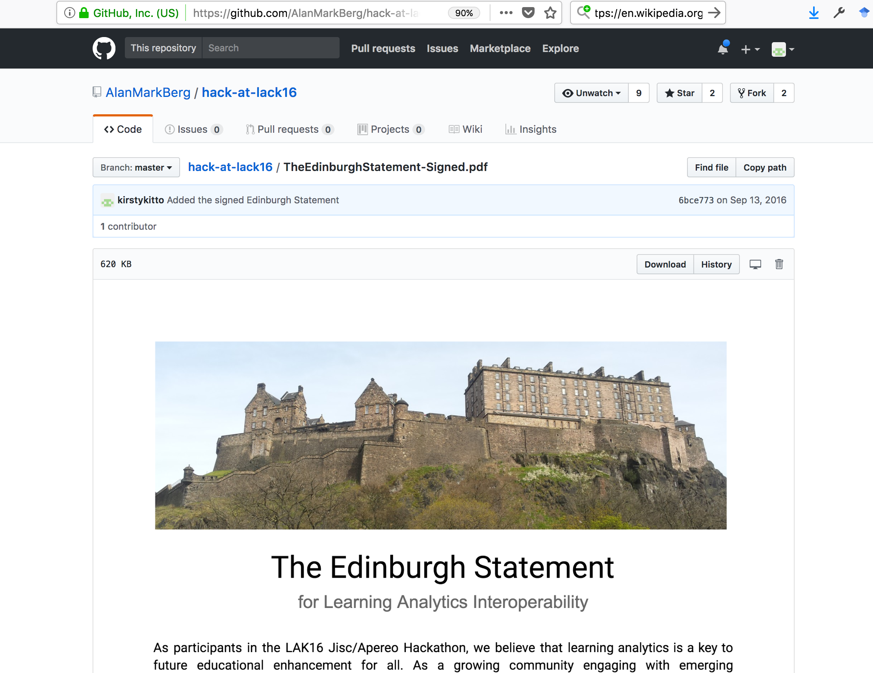
Hackathon has achieved lasting impact in a number of different areas

Slide 4
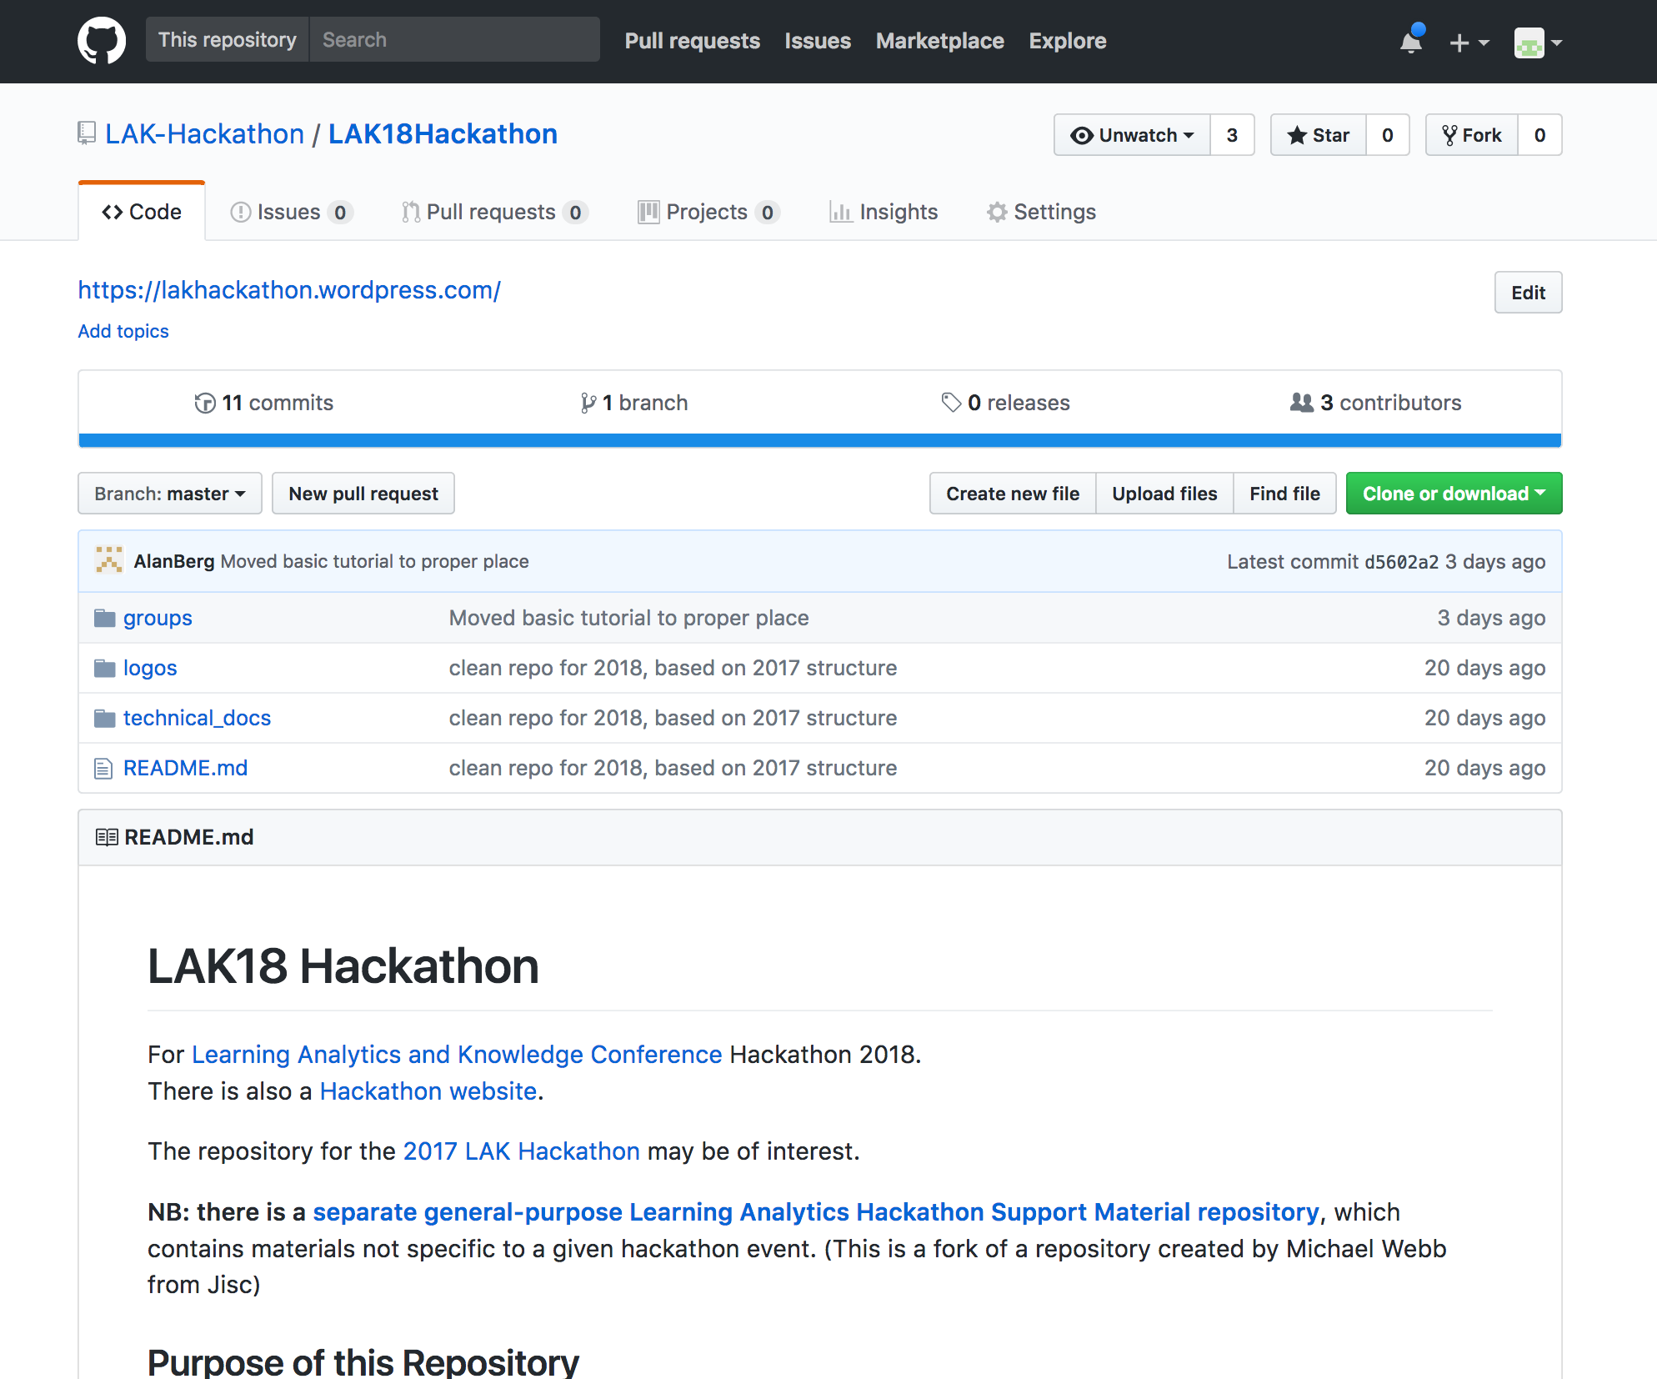
Resources and supporting infrastructure
https://github.com/LAK-Hackathon/LAK18Hackathon

Slide 5
Optimising e-portfolios through the means of xAPI and entity extraction of job advertisements
Alan Berg & Gabor Kismihok
https://docs.google.com/presentation/d/1s1UH_Z37YQK7wAaQfnMGwoElY9Yos-mNIDkkVVEsW4c/edit?usp=sharing

Slide 6
Hacking the Hackathon
https://docs.google.com/presentation/d/17nByLefROAqNcsDk8cMaGQtI-N5oYiwC7BNTRn6rTKs/edit?usp=edit

Slide 7
What role can Learning Analytics play in supporting university students to set goals for their own learning journey?
Gabor Kismihok and Catherine Zhao

Slide 8
Integrating privacy into an architecture for LA
George Ciordas-Hertel

Slide 9
General Data Protection Regulation (GDPR)
Right to be informed
Right to access
Right of rectification
Right to restrict processing
Right to erase
Right to data portability
Right to object
Right in relation to automated decision making and profiling

Slide 10
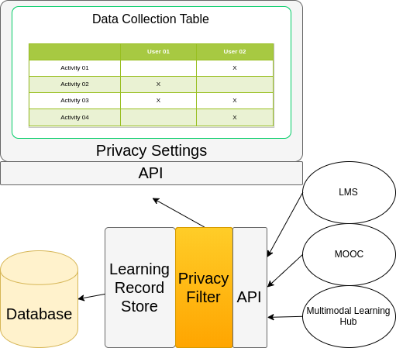
Right to object

Slide 11
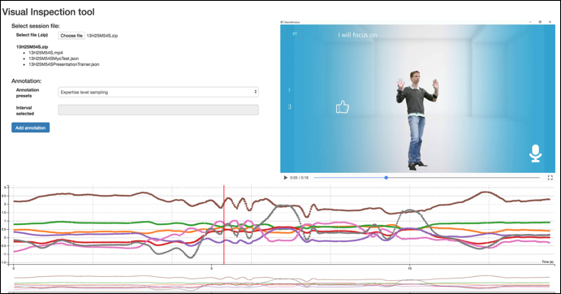
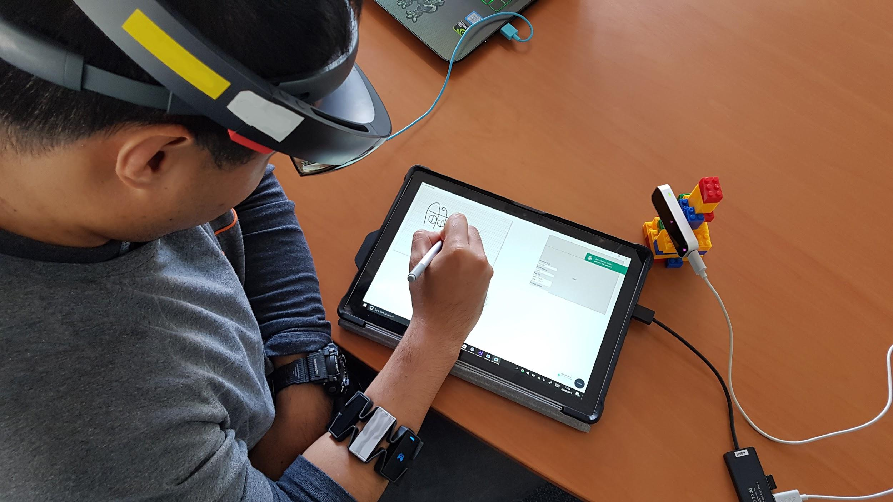
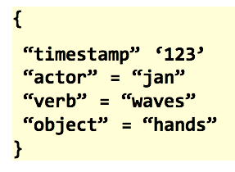
Multimodal challenge
analytics beyond user-computer interaction data
#multimodalhack
2) VIZ
Daniele Di Mitri & Jan Schneider
Info doc: http://bit.ly/MMLAhack
3 core groups:
1) HUB
3) XAPI

Slide 12
A Learning Analytics Data Literacy Playground
Tanya Dorey Elias, Anne-Marie Scott

Slide 13

Learning Analytics Data Literacy Playground
#LAKhackathon #LAK18
Anne-Marie Scott (Tanya Dorey-Elias, Samantha Ahern)

Slide 14

Which design processes involve learners, educators and other users effectively in the co-design of analytics tools?
Which techniques are effective in assessing how end-users make sense of, interact with, and act on analytics feedback?
In what ways can learning analytics systems be biased, and can they be made more transparent and accountable to different stakeholder groups?
How are educational leaders creating the conditions for learning analytics systems to take root and grow?
How strong is the evidence that the adoption of learning analytics benefits stakeholders?

Slide 15

Successful co-design of analytics tools requires that students have a baseline level of understanding as to what data about them are being collected and what they could be used for

Slide 16



1. Co-responsibility in an asymmetrical power and contractual relationship
…obligation to act is a co-responsibility of students and institution, tempered by the asymmetrical power and contractual relationship in which the institution has very specific moral and legal duties to respond
Image credit: https://pixabay.com/en/michelangelo-abstract-boy-child-71282/
Prinsloo, P & Slade S (2017) An elephant in the learning analytics room – the obligation to act, LAK17 presentation, https://www.slideshare.net/prinsp/an-elephant-in-the-learning-analytics-room-the-obligation-to-act

Slide 17

How to build critical data literacy skills?
How to develop awareness amongst students of the potential uses of their data and the possible consequences?
How to gather more information about student perspectives?
How to make algorithms open to interrogation?
How to build skills for working with and interrogating data itself?

Slide 18

Informed Consent

Slide 19

Learning Analytics Data Literacy Playground
Scaffolded activities
Synthetic data sets
Interrogation / experimentation / visualisation tools

Slide 20

Challenge assumptions
Reveal potential insights
Collect insights through in-built feedback
Playful, not scary

Slide 21

Brainstorm learning analytics use cases
Define activities
Develop data and tools
Develop feedback mechanisms
Packaging and delivery

Slide 22
Other challenges?
Throw your hat in the ring now…

Slide 23
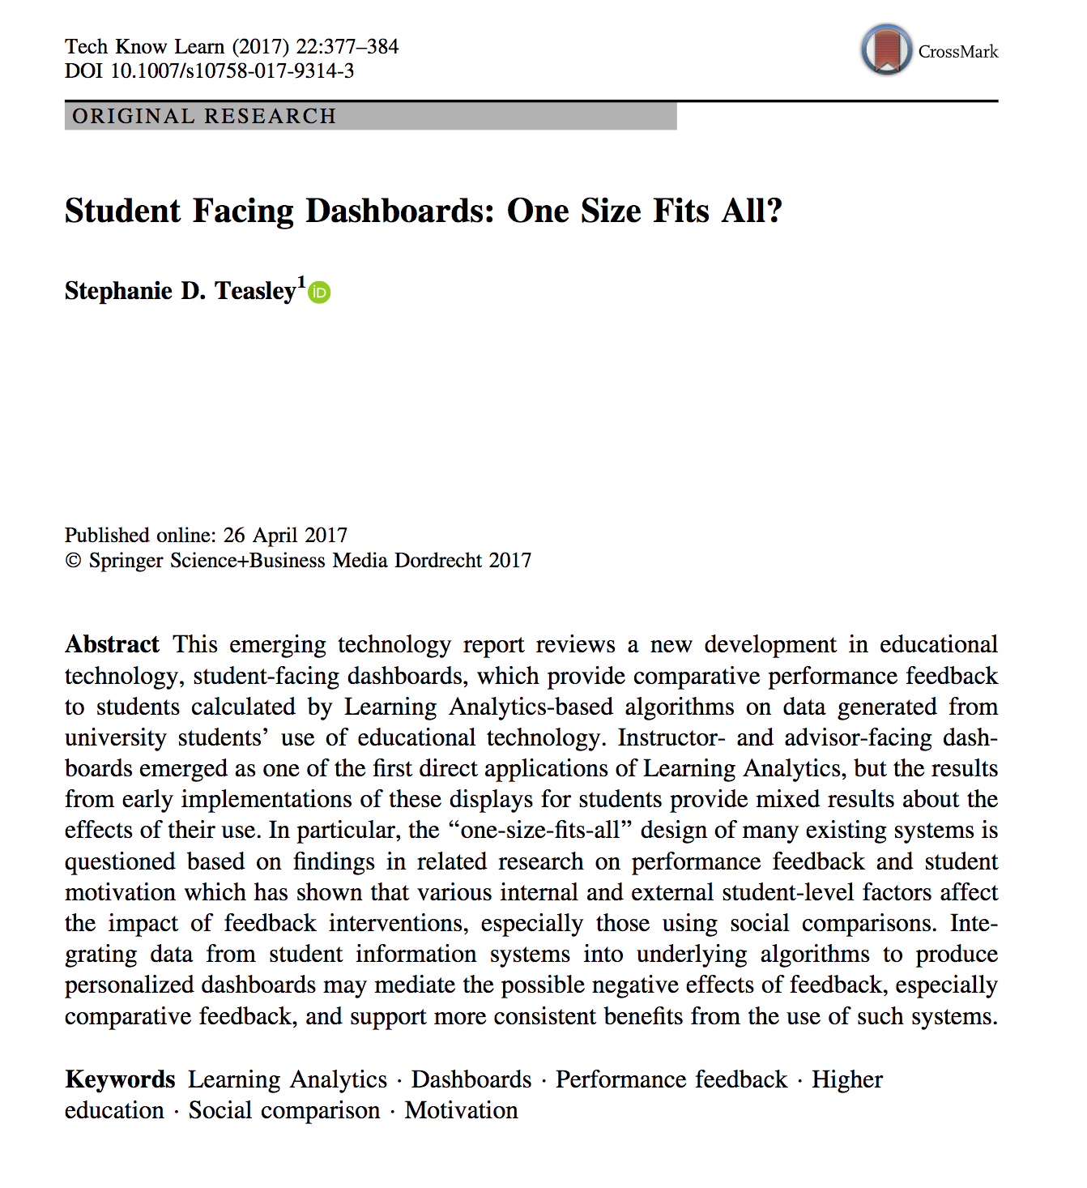
Customisable dashboards linked to learning design
Kirsty Kitto

Slide 24


Slide 25
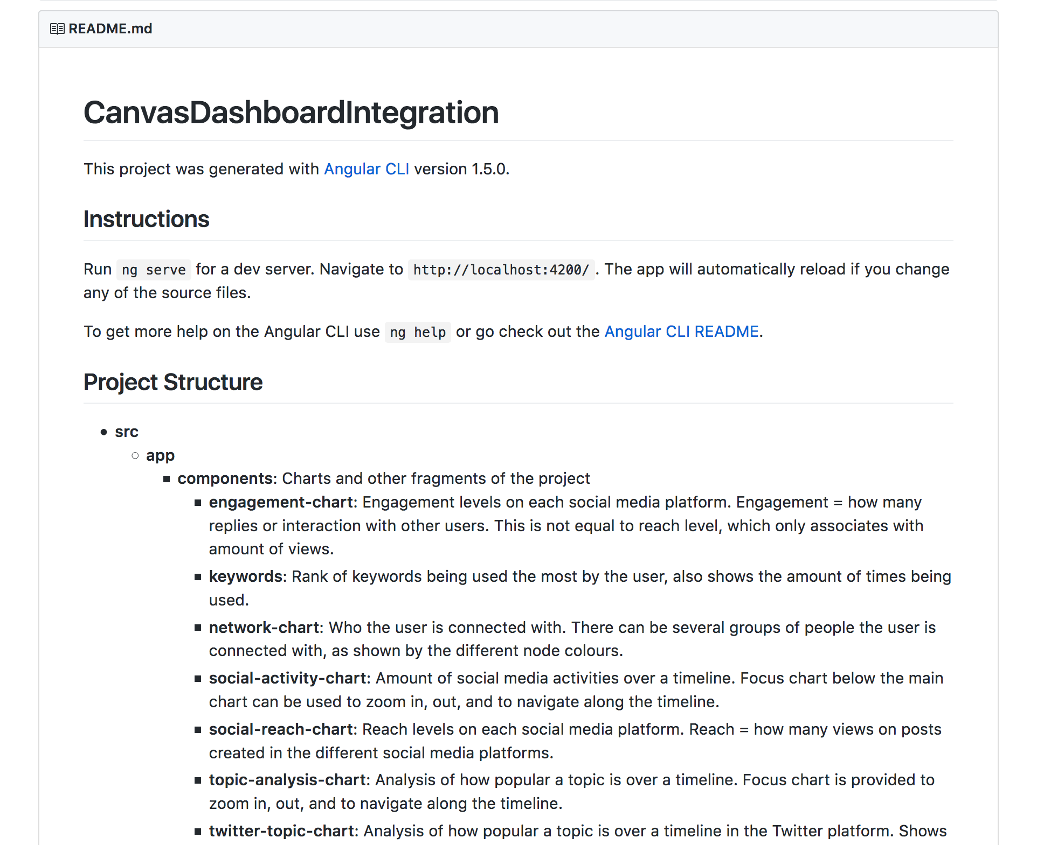
CIC repo is available…
angular front end with no connections

Slide 26
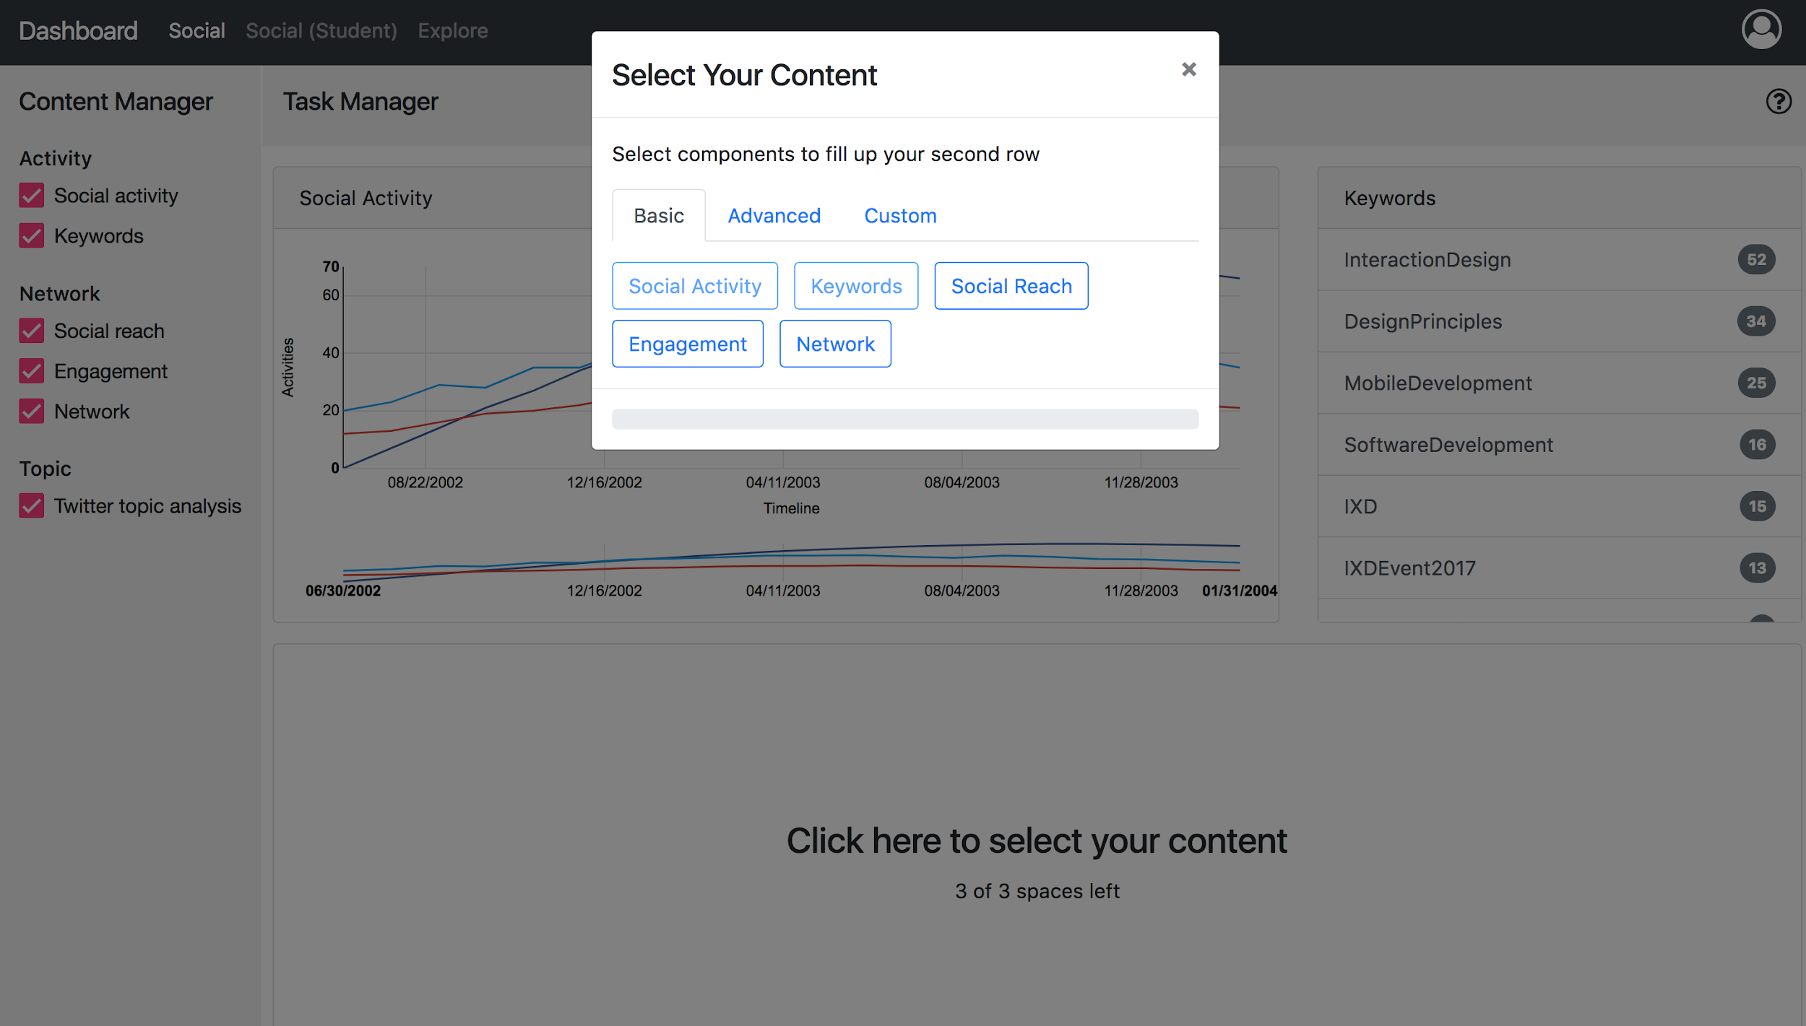
canvasdashboard.utscic.edu.au/

Slide 27
What Does Algorithmic Transparency Look Like?
(A micro-challenge riff… from Adam Cooper)
From a user-centred learning analytics perspective (which users)?
Resonances or dissonances?
Algorithmic accountability
Learning analytics data literacy playground

Slide 28
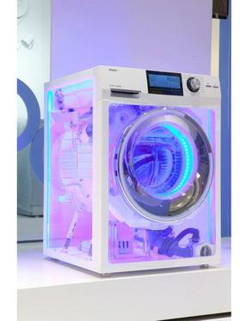
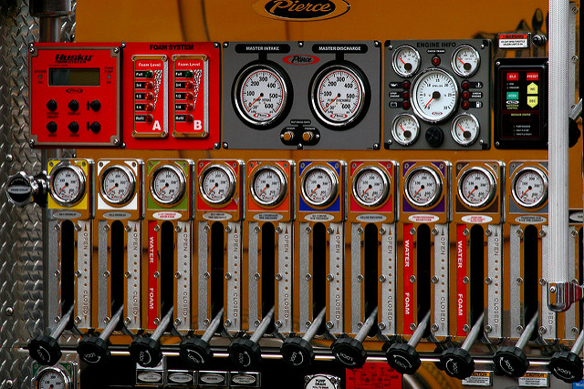
Transparent or Experiential?
What Does Algorithmic Transparency Look Like?

Slide 29
Synergies?

Slide 30
Time to start mingling around a challenge…
Groups will form after morning tea

Slide 31
Morning tea

Slide 32
Lunch

Slide 33
Afternoon tea

